Slide 1
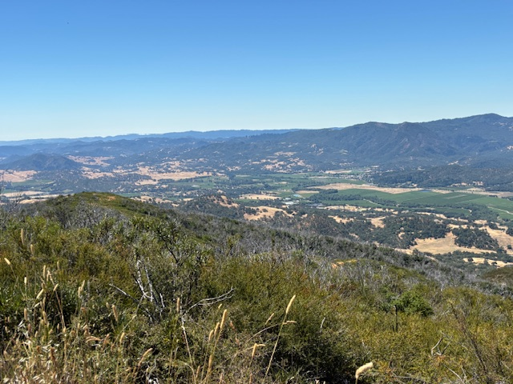
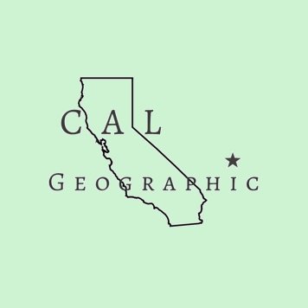
The Mighty Maacama
Tectonic Fracture Zone and Primary Plate Boundary
Rowena Forest, Cal Geographic

Slide 2
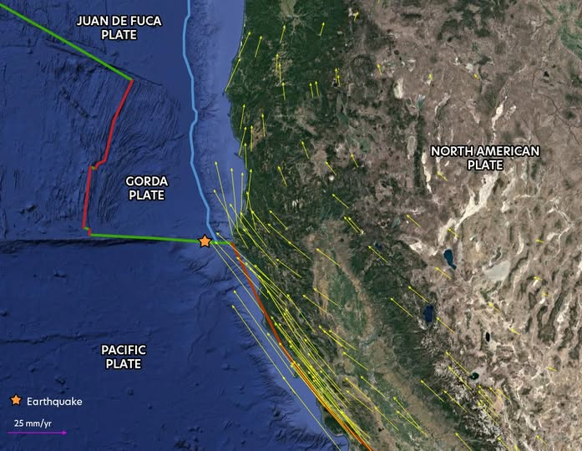
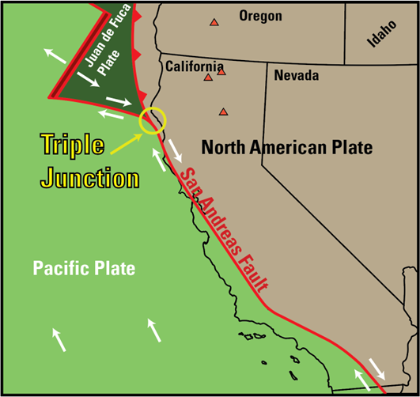
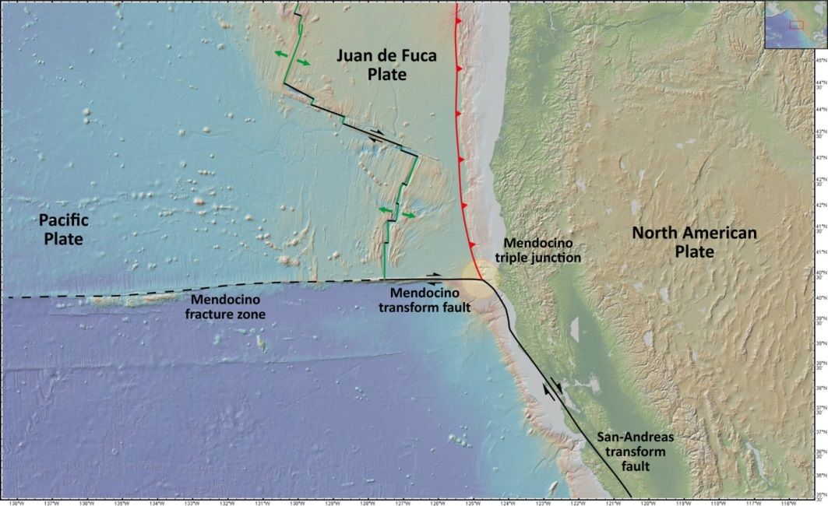
Mendocino Triple Junction
• Point of convergence of three tectonic plates ~20 miles west of Cape Mendocino
• Plates: Juan de Fuca/Gorda, Pacific, North American
• Boundaries: Cascadia Subduction Zone, San Andreas Fault, Mendocino Fracture Zone
• Complex multi-component mechanics: subduction, northwest migration/lengthening, compression, melting, thinning, and thickening of earth’s crust

Slide 3
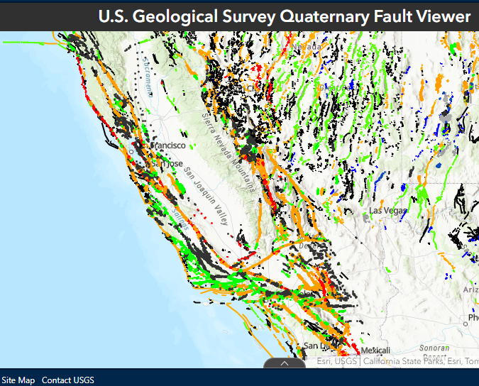
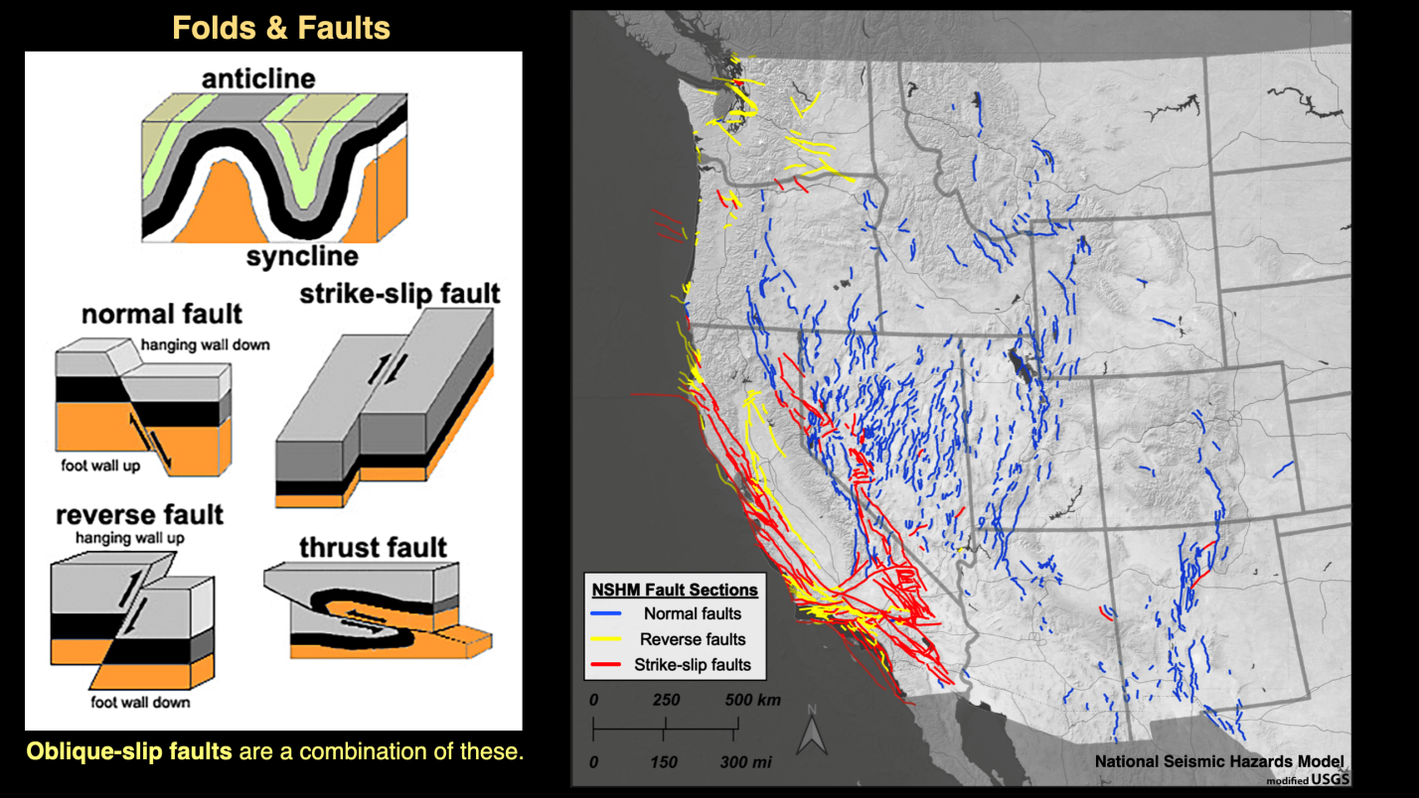
San Andreas Fault System
• Transform Plate Boundary and Fault System/Fracture Zone
• Young-ish: ~30 Ma – Farallon plate subduction and Pacific Plate contact
• Accommodates horizontal/oblique transverse motion of the Pacific and North American Plates

Slide 4
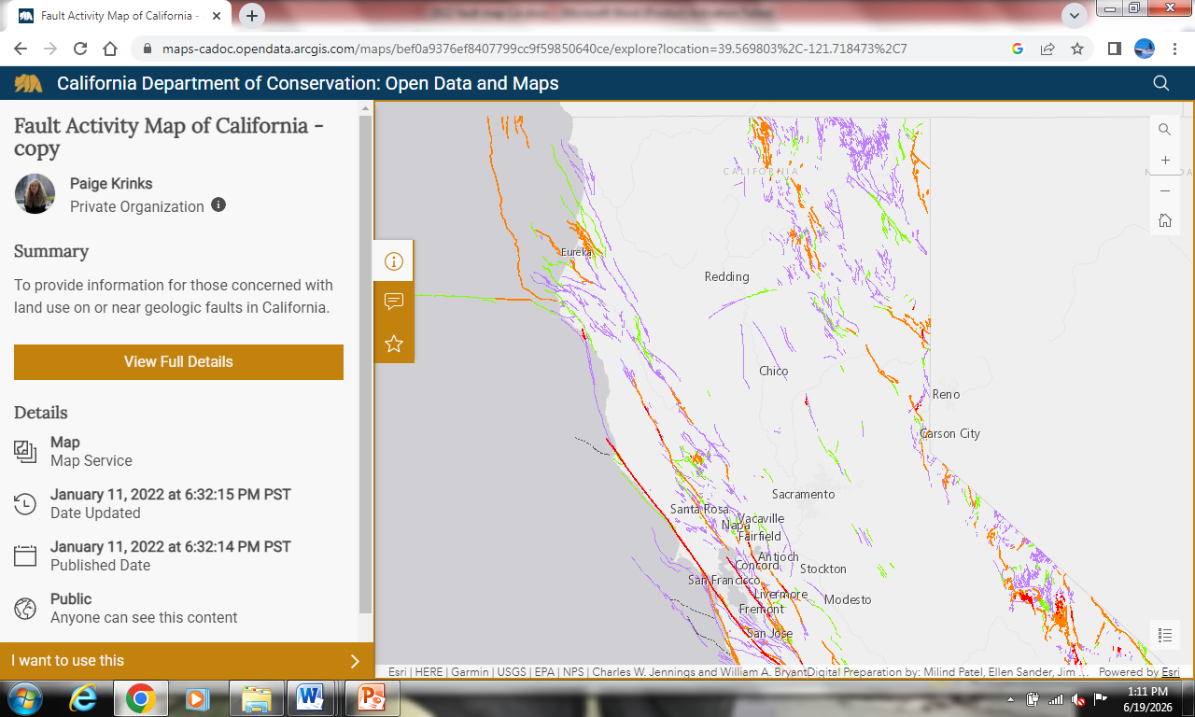
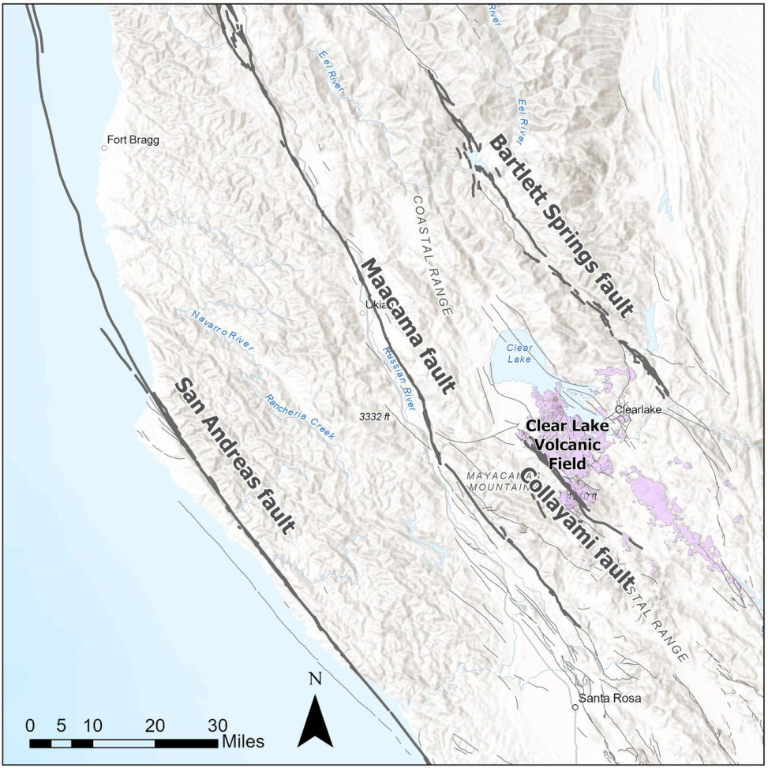
Maacama Fault and Hayward System
Maacama
• ~3-6 Ma – northernmost and youngest branch of Hayward Fault System
• Formed as northeast jump off of Rodgers Creek Fault with shifting motion of migrating MTJ and extension of SAF system
• Pull apart basins, 5-8mm/yr displacement
• Evolving, volatile, complex
Notes:
USGS

Slide 5
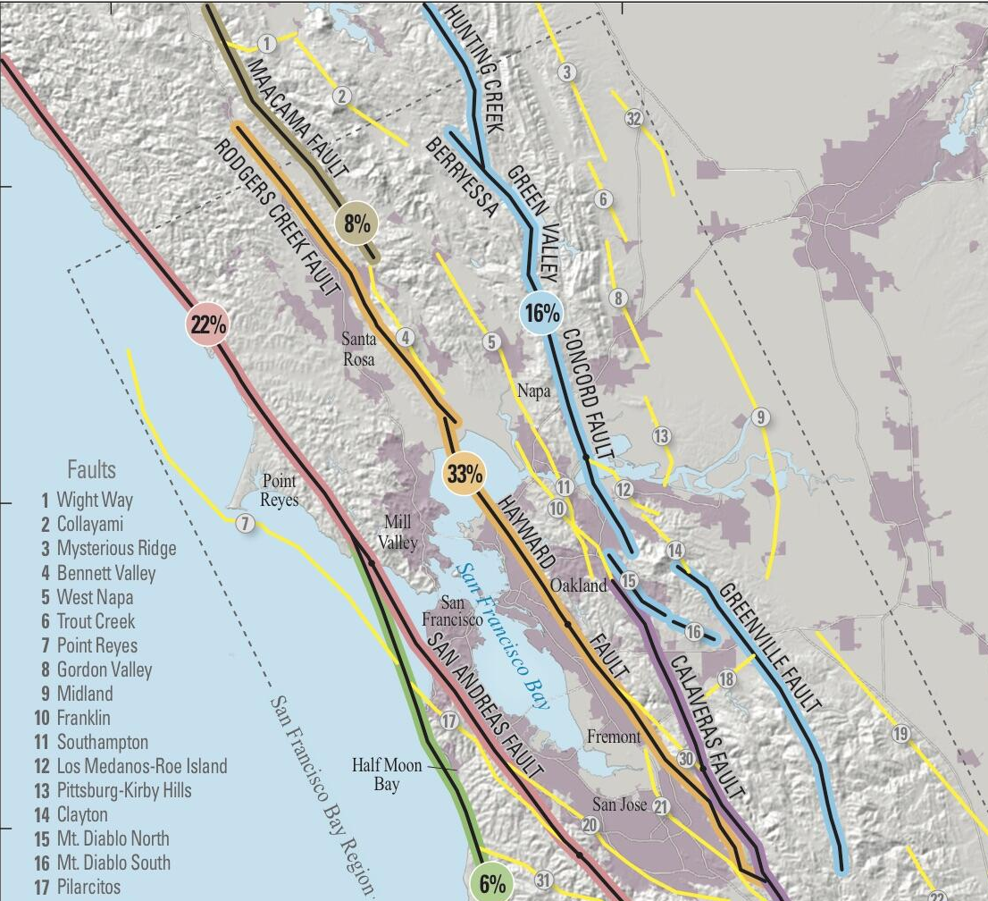
Maacama Fault and Hayward System

Slide 6
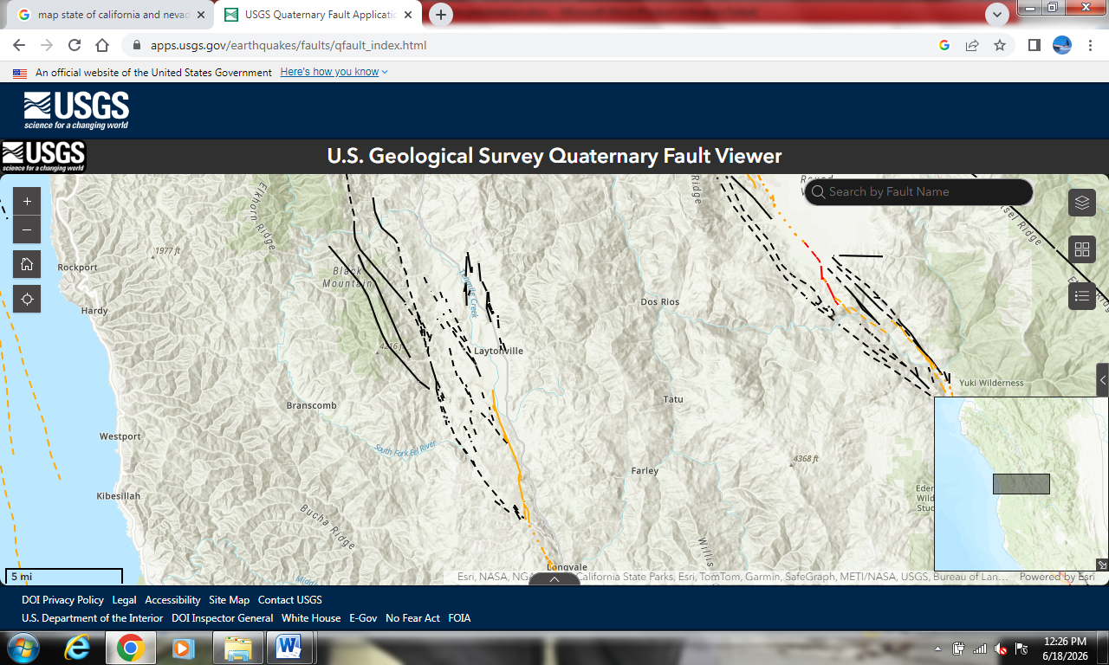
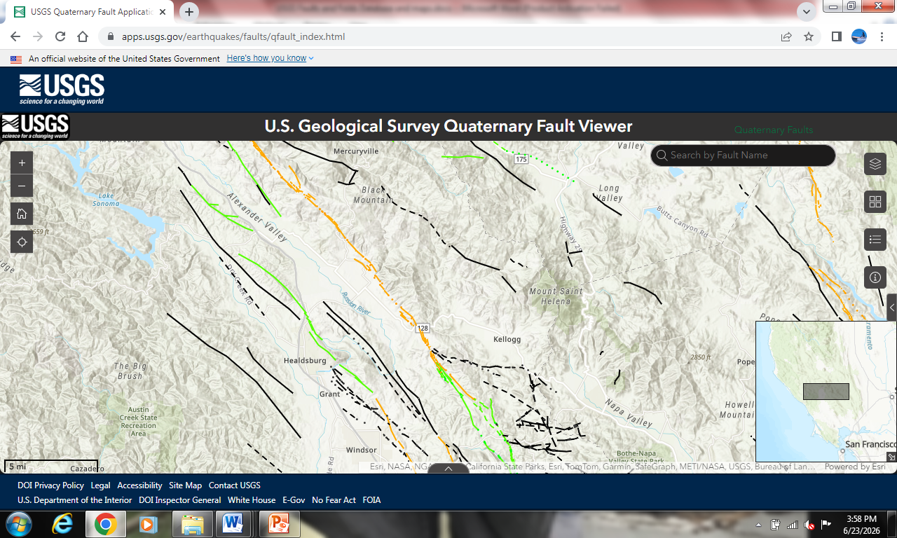
Maacama Fracture Zone
Northern End
• Splintered fracture network of fault strands
radiating out from a mainstem fault
• The Maacama is so fractured that the vast majority of fault strands associated with it have yet to be identified
• Strands/faults are identified with seismic activity, or with topographic evidence as tectonic landforms
Southern End

Slide 7
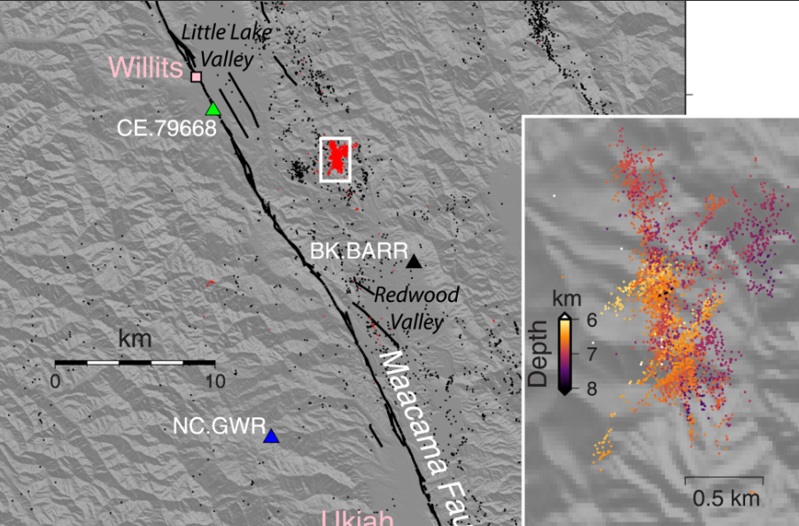
Maacama Fracture Zone
• Swarms of small earthquakes and interlocking faults can be so numerous that they form what is known as a mesh, or a fracture mesh
• Earthquake swarm in active seismic zone between Redwood Valley and Willits, 2020
Recent work resolves an earthquake swarm that initiated on the Maacama Fault but activated an en echelon network of conjugate faults that define a fracture mesh, which demonstrates that deformation is more complex than a single throughgoing fault (Shelly et al., 2023).
Notes:
Shelly et al 2022

Slide 8
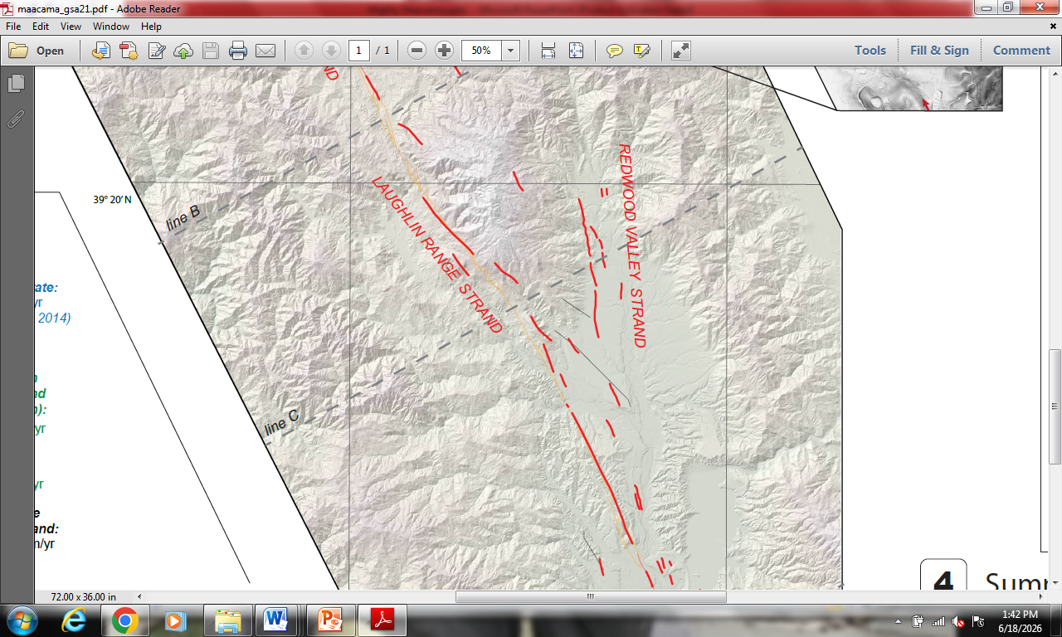
Maacama Fracture Zone
Redwood Valley Fault Strand
• “New” major segment of the Maacama Fault and Fracture Zone identified in 2021
• June earthquake will instigate identity of new strands
Notes:
Trexler et al 2021

Slide 9
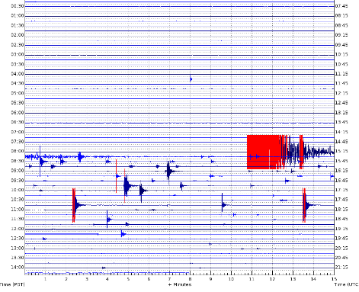
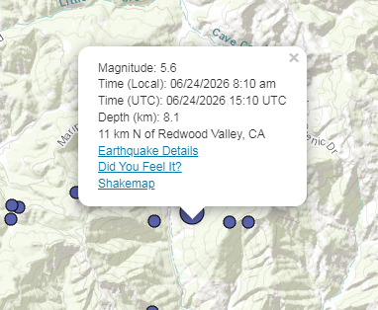
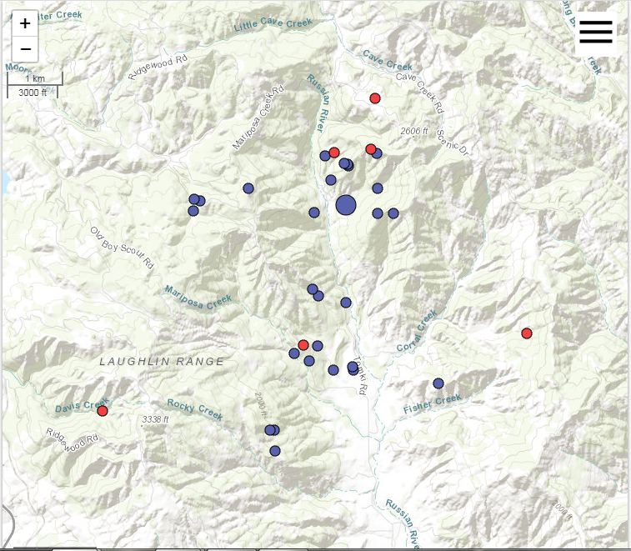
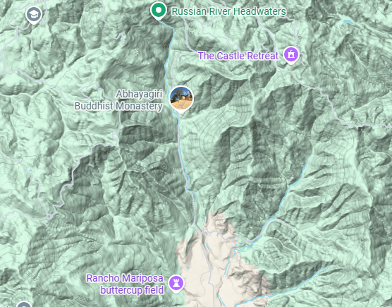
June 24, 2026 Earthquake on the Maacama Fracture Zone
• Largest earthquake recorded on the Maacama
• Magnitude 5.6 on previously unknown fault strand in upper Redwood Valley
• 35 aftershocks >1.3 within six hours of quake
Earthquake reading from the seismic monitoring site at Cow Mountain

Slide 10
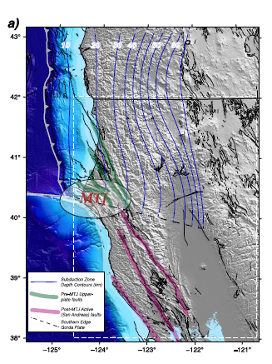
Primary Plate Boundary and Deep Tectonic Shear Zone
• The Maacama Fracture Zone (MFZ) is the primary Plate boundary between the North American and Pacific Plates in Northern CA
• The MFZ is a deep sheer zone that reaches down into the lower lithosphere
• The MFZ also creates a boundary with the Slab Window - an area of thinner crust that allows asthenospheric material/magma to upwell closer to the surface of the earth
• The Slab Window forms as the migrating Mendocino Triple Junction (MTJ) overtakes the edge of the subducting Gorda Plate and severs it, which leaves a gap/window beneath the earths crust just southeast of the MTJ
• Do we see influence of the Slab Window on the landscape?
Subducting Gorda Plate
Slab Window
Maacama

Slide 11
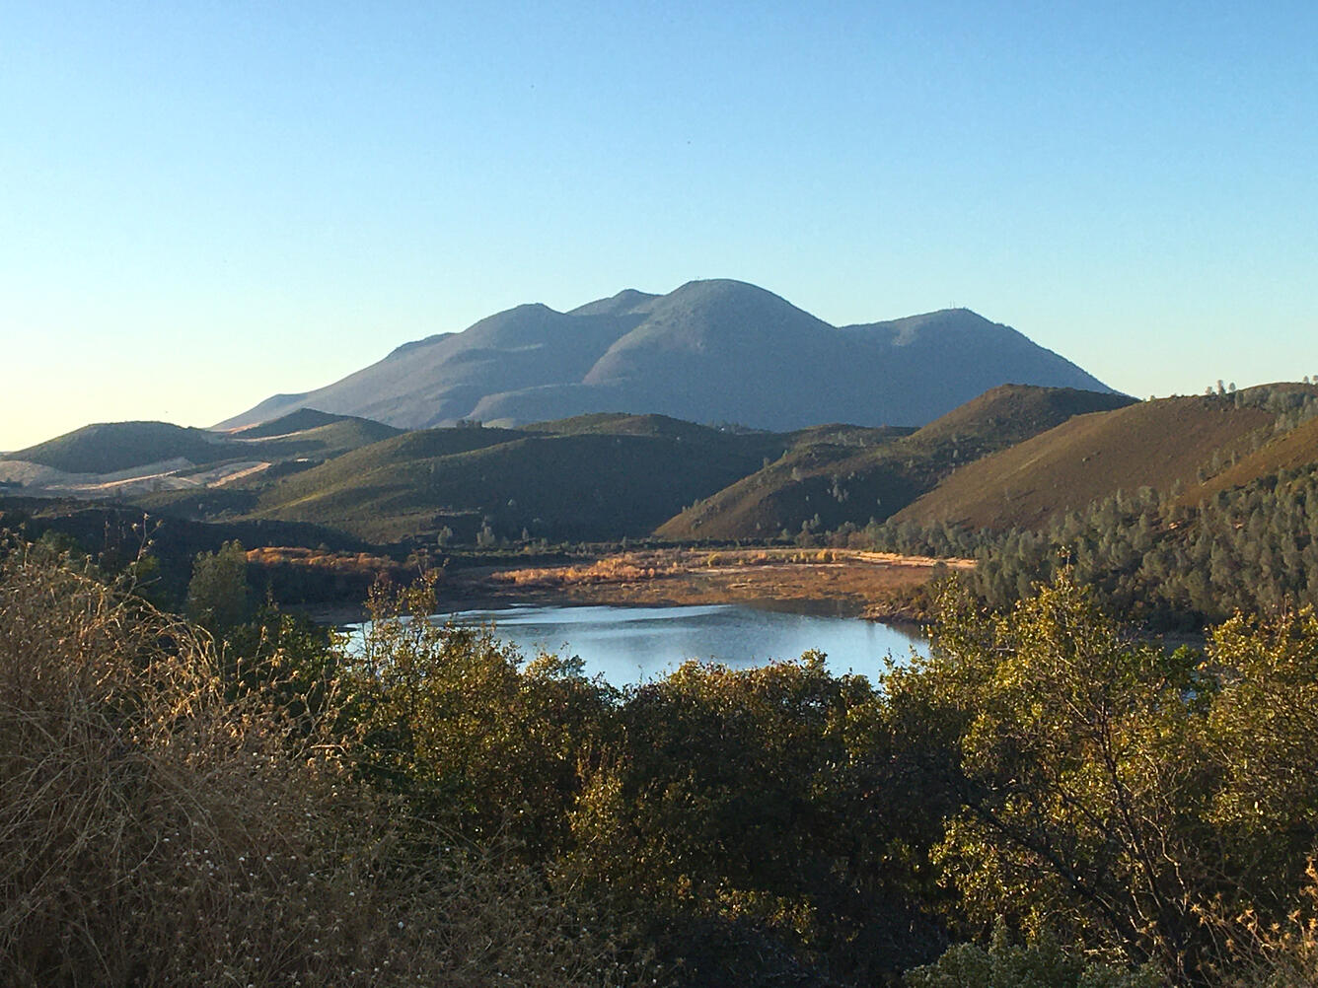
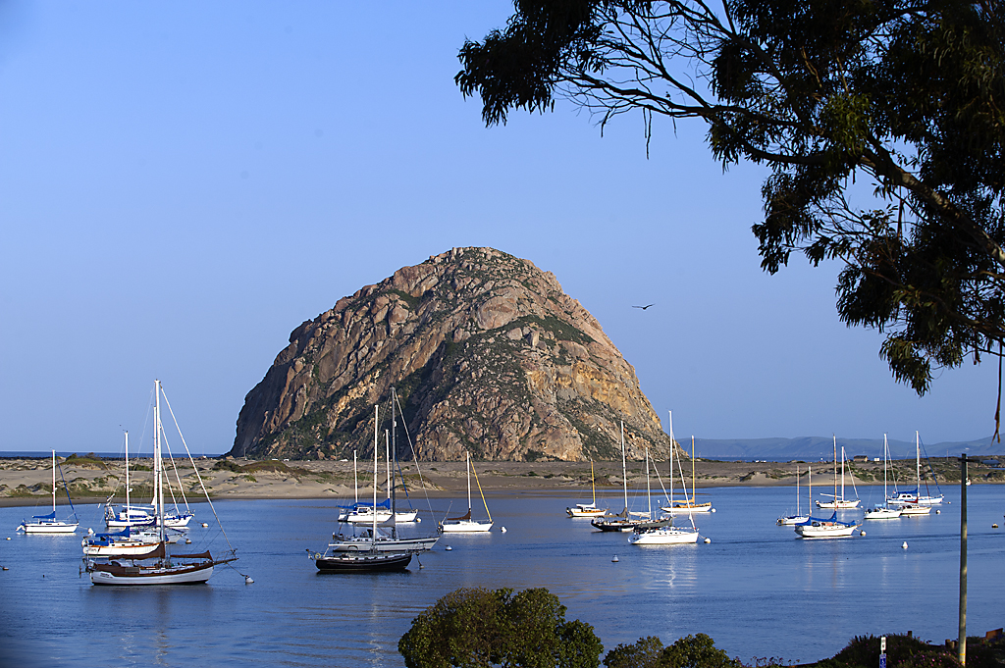
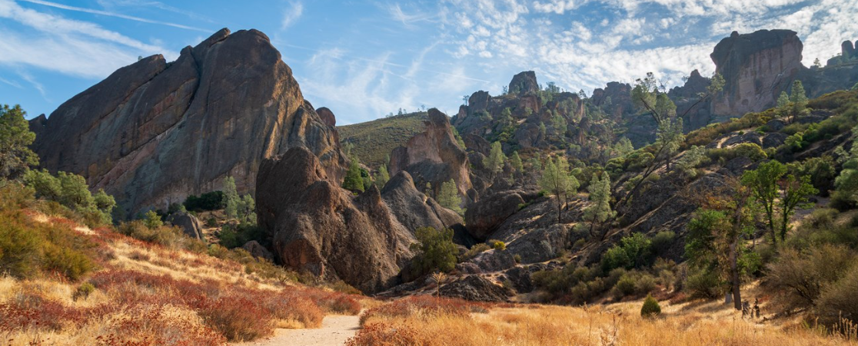
Yes!
Morro Rock
~ 20 Ma
Clear Lake Volcanic Field ~Current/Active
• Migrating MTJ and Slab Window leave trail of volcanic landforms throughout Coast Ranges from ~27 Ma to present, S to N
• Current Slab Window activity: Napa, Lake, &Mendocino Counties
The Pinnacles National Monument
~23-24 Ma
Notes:
Public domain usgs

Slide 12
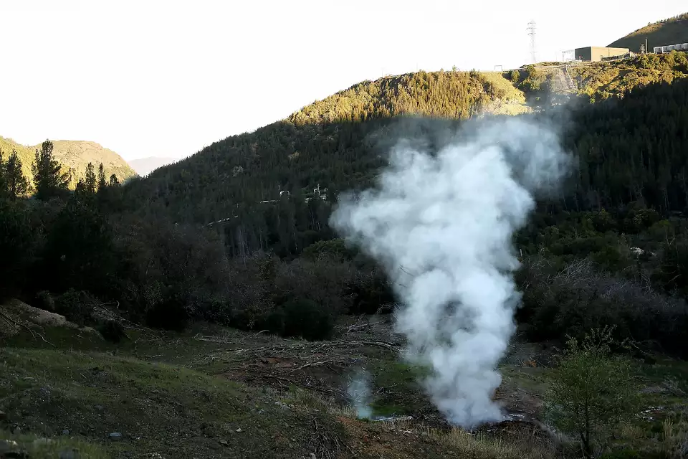
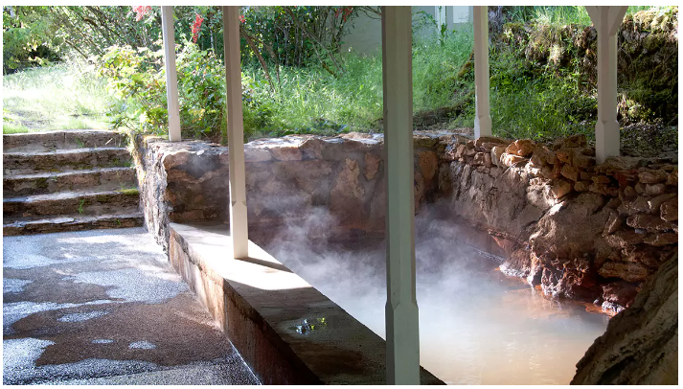
Slab Window Geothermal and Hydrothermal Activity
Geysers and hot springs of Napa, Lake, & Mendocino Counties

Slide 13
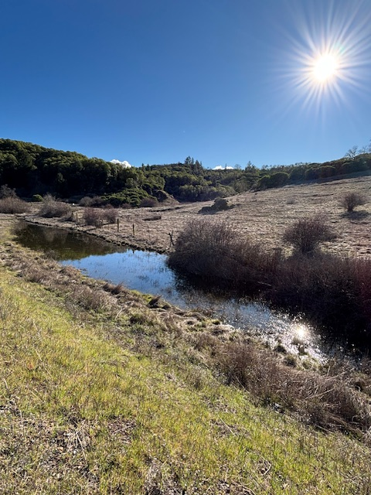
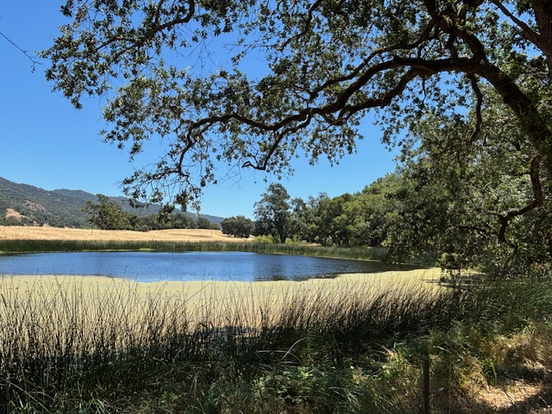
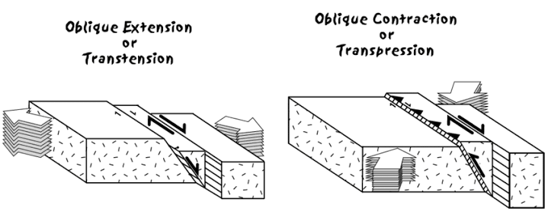
Tectonic Landforms of the MFZ
Transtension
• Regions of extension or transtension within tranform tectonic fault zones
• Basins can form when each side of a transverse fault is pulling away from itself, or two adjacent transform faults are moving away from each other – stretching the middle ground like taffy
• Creates transtensional pull-apart basins, such as sag ponds or larger basins such as the Santa Rosa Plain, Anderson Valley, or Little Lake Valley
Notes:
Transform Tectonic Landforms

Slide 14
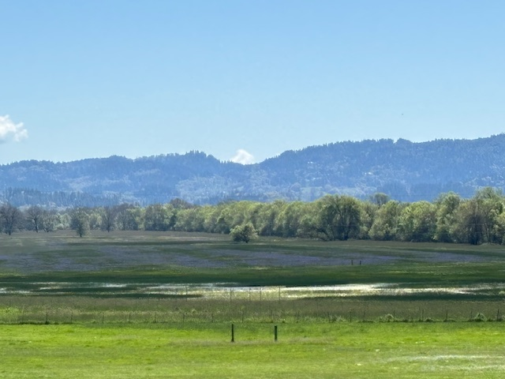
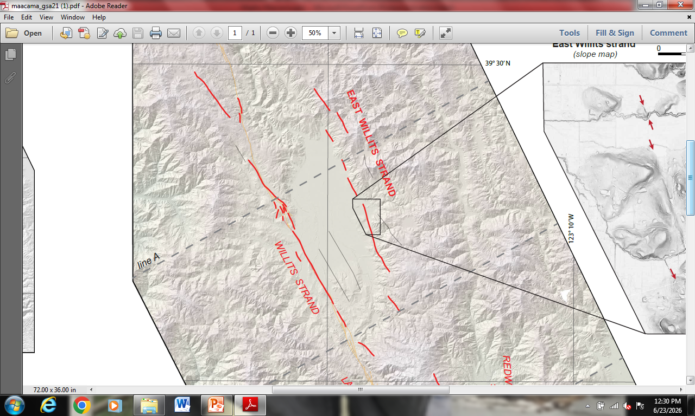
Tectonic Landforms of the MFZ
Transtension
Willits Bypass Wetlands Mitigation Lands with Blue Camas Lily bloom
• Little Lake Valley transtensional basin formed as the Willits strands and East Willits strands of MFZ create extension between them and a pull-apart basin

Slide 15
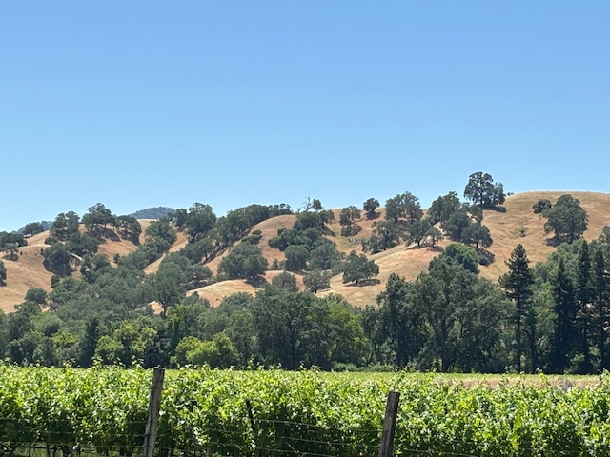
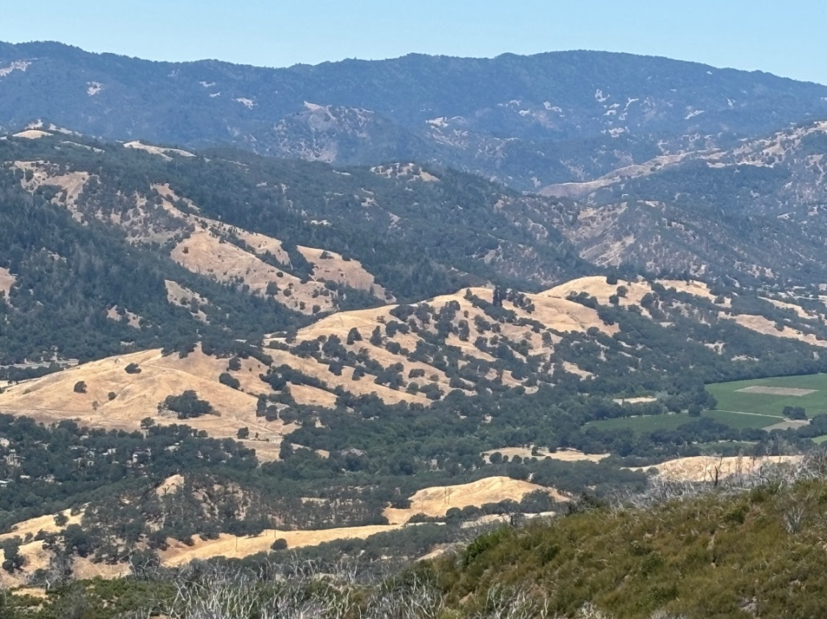
Tectonic Landforms of the MFZ
Transpression
• Mechanics of oblique transform fault system involves a lot of collision as the plates grind past and into each other
• This compression, or transpression, creates uplift of the land and compressional landforms
Transpression ridges along strands of the MFZ near Sanel Valley

Slide 16
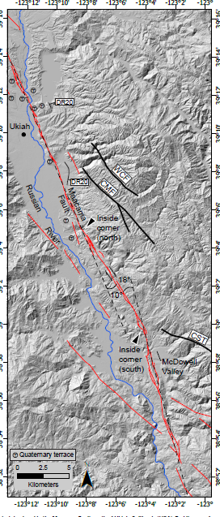
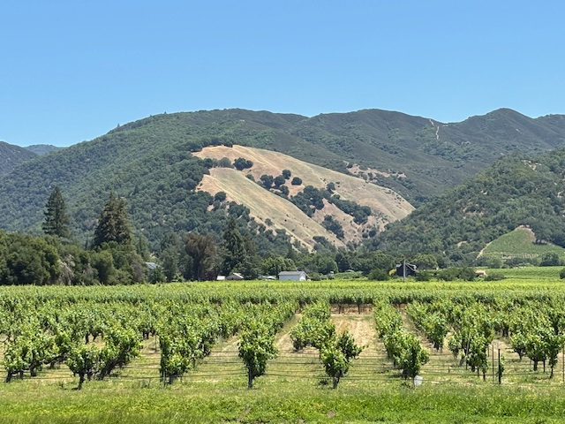
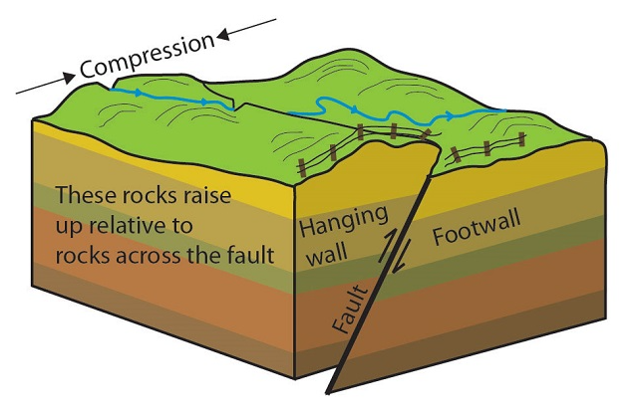
Tectonic Landforms of the MFZ
Transpression - Thrust Faults
• Transpressional forces in a transform system also create numerous thrust faults when one side of a landmass compresses into and thrusts over another
• Thrust faults, and fold and thrust belts are primary contributors to the formation and uplift of the steepest slopes and ridgelines throughout Mendocino and the north Coast Ranges.

Slide 17
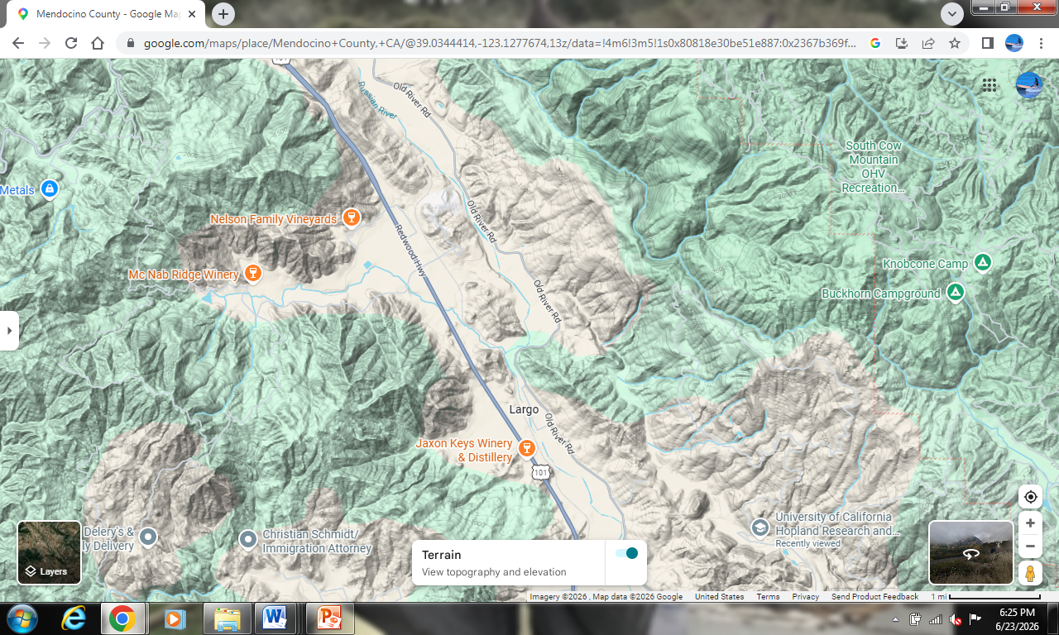
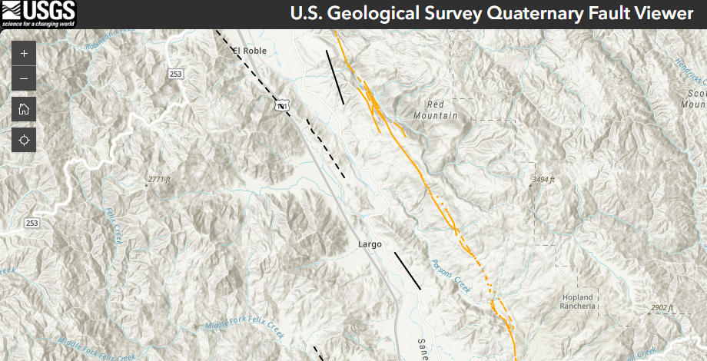
Morrison Creek Thrust
and
Parsons Creek Thrust
Creeks running laterally along (not down) the steep slopes of Red Mountain atop uplifting compression ridges of thrust faults
Notes:
Thrust features at UC Hopland Center: Parsons creek valley/Parsons Thrust, Morrison Creek valley/Morrison Thrust, Hogan and Hog Lakes, thrust and pressure ridges view from above, super steep slopes of Red Mountain due to thrust uplift/compressional ridges of thrust belt

Slide 18

Franciscan Complex Geologic Belts of the North Coast Ranges
• Three distinct belts of Franciscan Complex geologic units
• Increasing in age from west to east
• The Maacama Fracture Zone forms the border between the Coastal Belt and Central Belt, along with the Coast Range Thrust
Eastern Belt
Central Belt
Coastal Belt

Slide 19
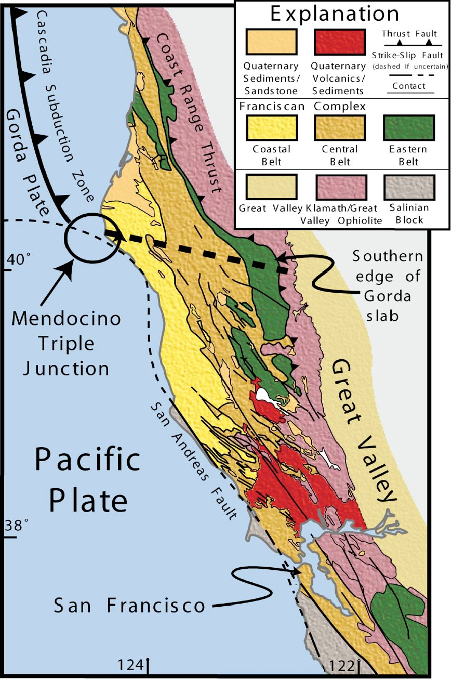
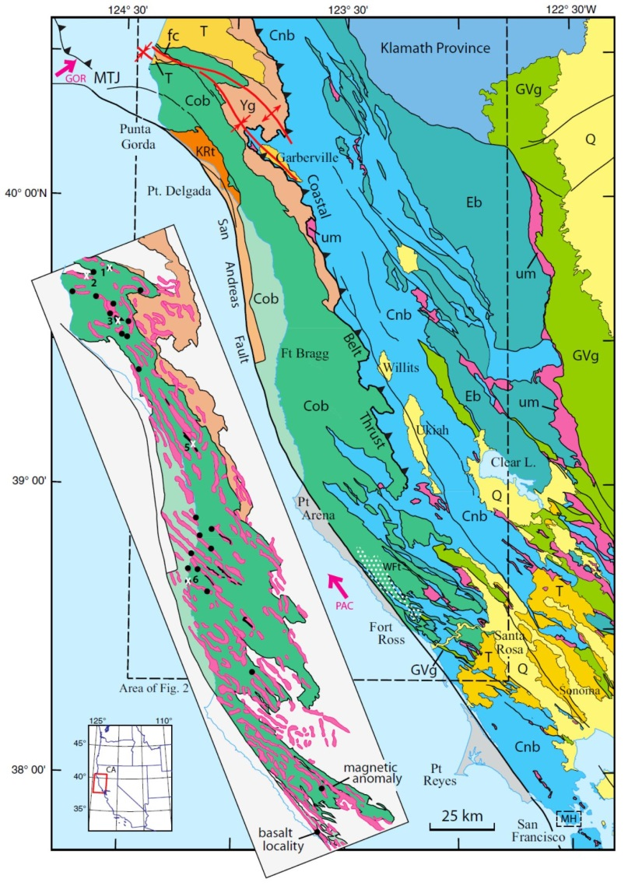
Franciscan Complex Geologic Belts of the North Coast Ranges
• The Coastal, Central and Eastern Belts of the Franciscan Complex formed as the accretionary wedge prism of the Mesozoic era subduction of the Farallon plate beneath the North American plate
• The foothills of the Coastal Belt can be seen to the west of the Maacama Fracture Zone, and the foothills of the Central Belt can be seen to the east of it

Slide 20
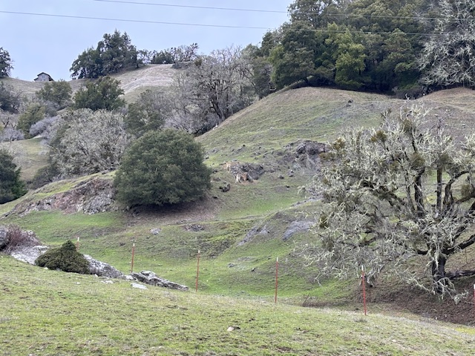
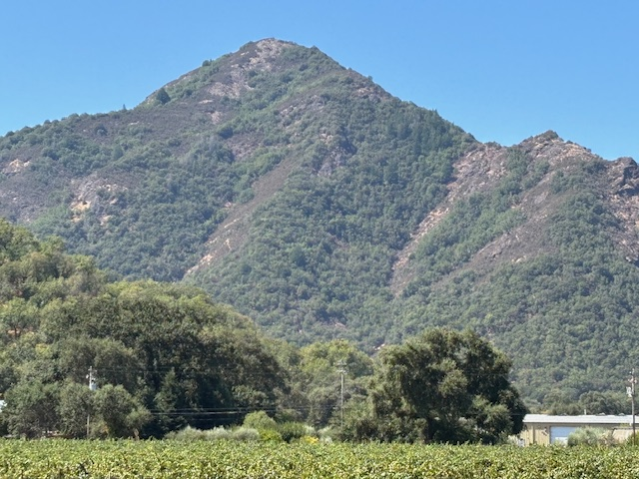
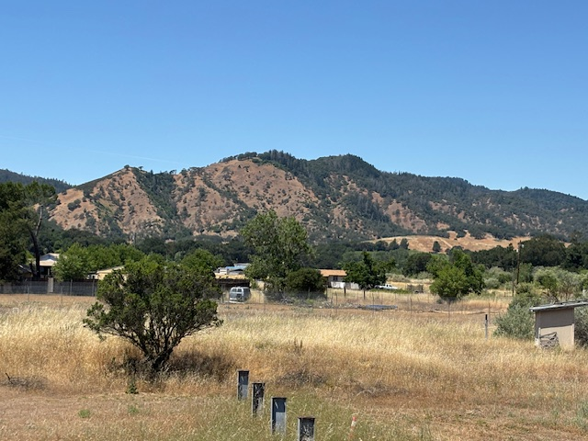
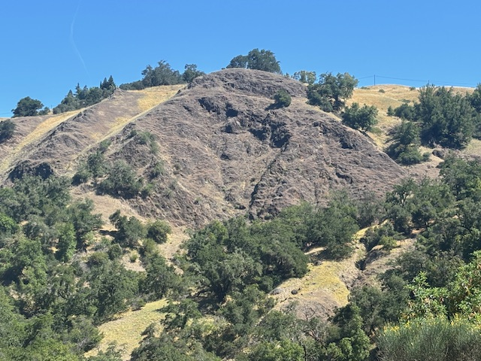
Coastal Belt Foothills Geology and Geomorphology
• West side of the Maacama “central valleys”/101 Corridor
• Youngest of the three geologic belts, primarily Greywackes
• Rumply erodible serpentinite landscapes, steeply rolling repeated angular landforms of fold and thrust belts
Notes:
Duncan Peak hopland, find out if lower left is a fold belt/thrust belt? And named?

Slide 21
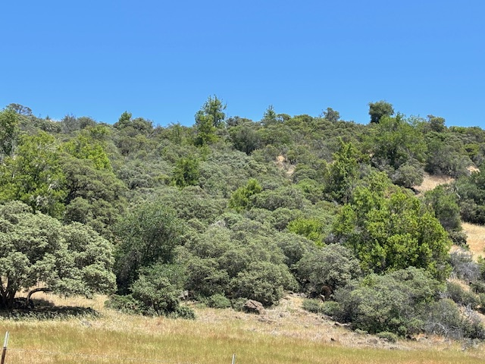
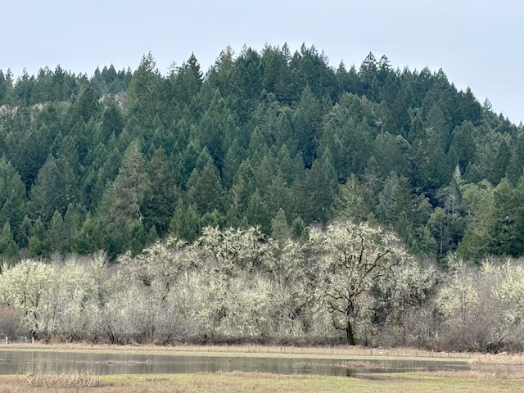
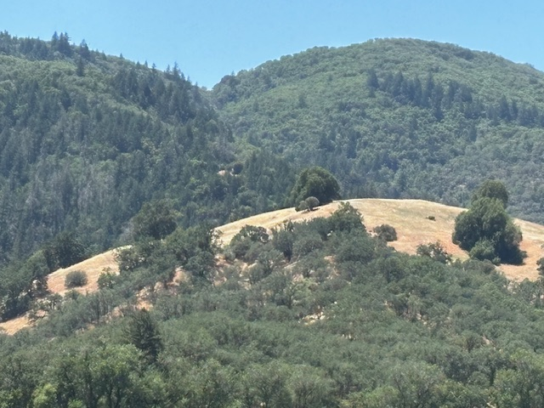
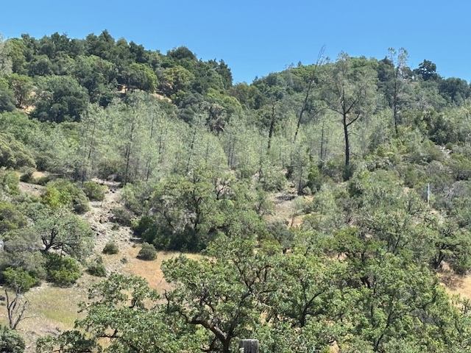
Coastal Belt Foothills Ecosystem Mosaic
Northern Coast Range Evergreen Forest
Coastal Belt Mixed Chaparral
Chaparral- Madrone-Evergreen mosaic
Mixed Oak-Madrone-Gray pine Woodland
Blue oak Woodland and Oak Savannah

Slide 22
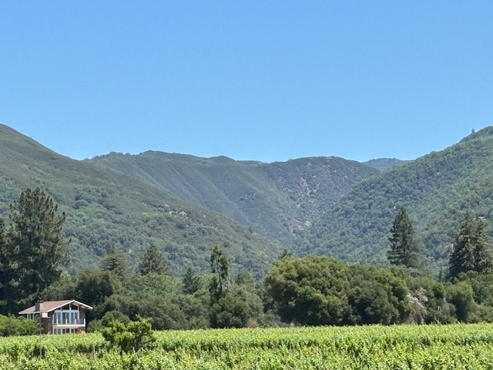
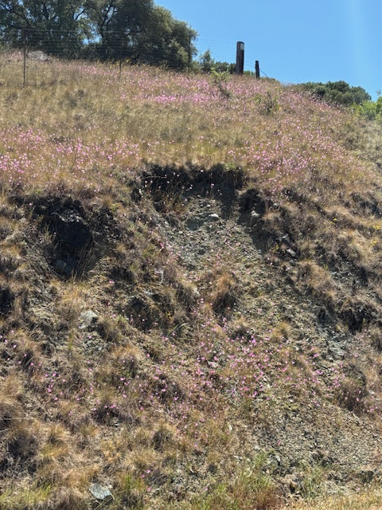
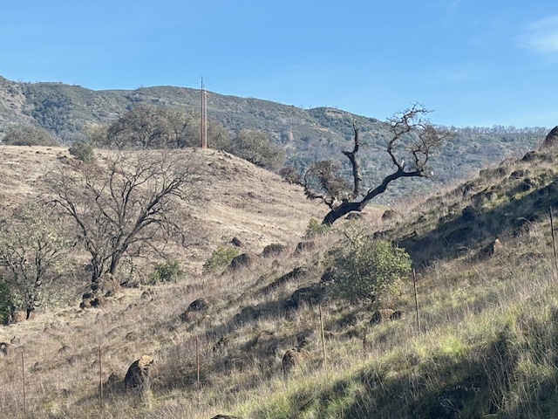
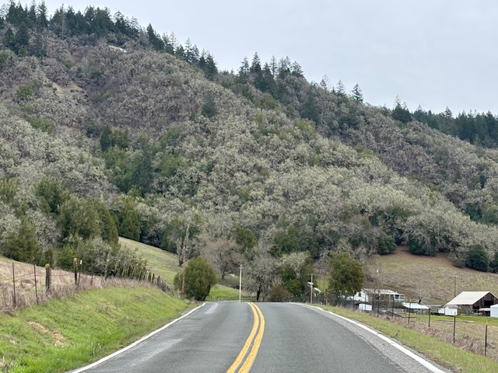
Central Belt Foothills Geology and Geomorphology
• East side of the Maacama “central valleys”/101 Corridor
• Older and moderately metamorphosed Franciscan Complex geologic units
• Massive blocky compressional ridges and mountains rapidly uplifting along thrust belts

Slide 23




Central Belt Foothills Ecosystem Mosaic
High elevation Central Belt Chaparral
Foothill Oak Woodland
High elevation Central Belt Chaparral
Foothill Oak Savannahs
Deciduous Oak Woodland – Evergreen mosaic
Central Belt Chaparral

Slide 24

Birding hotspots and geographic info within the Central Belt, Coastal Belt and Maacama Fracture Zone
https://www.peregrineaudubon.org/spots.html

Slide 25



Fault Creep in Downtown Willits
• Creep is steady aseismic movement and displacement along a tectonic fault
• Creep occurs along an estimated 80% of the Maacama Fault
• Visible in urban or built environment: pavement, structures along the creeping strand of fault
• Creep theories applicable to MFZ: friable geologic environment (serpentinites etc); presence of high pressure fluids/gasses/magma within the fracture zone

Slide 26



Effects of fault creep on historic home in Willits – the Maacama bisects the property diagonally through the front porch

Slide 27



Ojeda, 2017
Maacama Fault
Today – Adventist Hospital and expanded subdivisions constructed on the Maacama fault

Slide 28



Resources for Past and Current Earthquakes Tracking
https://earthquakes.berkeley.edu/station_book/hops.html
https://www.usgs.gov/california-volcano-observatory

Slide 29


Thank You!
https://calgeographic.com/
Field Trips:
• Upcoming field trips are listed on Cal Geographic
• MFZ field trip possibilities?: UC Hopland Center fault and sag ponds, Downtown Willits fault creep walkabout, Redwood Valley tectonic foothills/Frey foothills

